Slide 1
Project Presentation of CO-OP Project at Industry (Module-2) (22CS421)
On
GeoCom-Edu: A Generative Comic Framework for Lecture Summarization
Pranzal Yadav | Shivain Chhibber | Gursewak Bhatia
2210992067 | 2210992303 | 2210991600
pranzal2067.be22@chitkara.edu.in | shivain2303.be22@chitkara.edu.in | gursewak1600.be22@chitkara.edu.in
Supervised By
Department of Computer Science and Engineering, Chitkara University
Department of Computer Science and Engineering,
Chitkara University, Punjab

Slide 2
Introduction
Background & Motivation
Digital education has expanded access to recorded lectures worldwide, but long 60-90 minute videos are difficult to navigate and retain
Traditional transcription tools convert speech to text with little support for comprehension or interaction
Problem
Students struggle to extract key concepts from unstructured lecture recordings
Existing AI tools are fragmented — transcription, summarization, and Q&A exist in isolation
Most solutions depend on paid cloud APIs, raising privacy and cost concerns for students and institutions
Visual learning aids are largely absent from current educational AI tools
About GeoCom-Edu
GeoCom-Edu is a fully offline, privacy-first AI platform that integrates ASR, NLP, RAG, and generative visualization into a single unified system
Developed as a Final Year B.E. CSE project at Chitkara University, Rajpura
2

Slide 3
Problem Statement
Key Challenges Addressed
Information Overload: Students struggle to sift through 60-90 min lecture videos and retain key concepts
Disconnected Tooling: Existing tools handle transcription or summarization individually — no unified solution exists
Privacy and Cost: Most tools rely on paid cloud APIs, raising data privacy concerns and cost barriers for educational use
Lack of Visual Engagement: No tools automatically transform lecture content into interactive visual learning materials
Research Gap
Despite advances in speech recognition, NLP, and image generation individually, a lack of integrated offline solutions tailored for education remains
No existing platform combines all four capabilities: transcription, summarization, context-aware Q&A, and comic visualization in one offline system
3

Slide 4
Proposed Solution
Proposed Solution: GeoCom-Edu
A modular, fully offline AI platform that transforms lecture videos into structured, interactive, and visually engaging learning material
Four-Layer Pipeline
ASR Layer: YouTube/video input processed via yt-dlp, transcribed using OpenAI Whisper with timestamps and multi-language support
NLP Layer: BERT-based topic segmentation divides lectures into sections; BART/PEGASUS generates concise summaries with keyword extraction
RAG Chatbot: FAISS vector database indexes segment embeddings; LLaMA 3 generates context-aware answers to student queries — fully offline
Comic Visualization: Stable Diffusion converts lecture summaries into illustrated comic panels to aid visual learners
Implementation Stack
Backend: FastAPI orchestrates AI workflows and exposes REST API endpoints
Frontend: React.js single-page application with Transcript, Chat, and Comic tabs
Database: MongoDB stores transcripts, embeddings, and conversation history
4

Slide 5
System Architecture
System Architecture Overview
The system follows a sequential modular pipeline: Input → ASR → NLP → RAG → Comic Visualization
Each module operates independently and can be updated or replaced without affecting the rest of the pipeline
Module Details
Input Module: Accepts YouTube URLs or local video files; yt-dlp extracts audio stream and converts to WAV format
ASR Module (Whisper): Transformer-based speech recognition produces timestamped transcript with high accuracy across accents and noise conditions
NLP Module: BERT embeddings segment the transcript by topic; BART/PEGASUS summarizes each segment; keywords extracted for FAISS indexing
RAG Chatbot (LLaMA 3 + FAISS): User queries matched to relevant transcript segments via cosine similarity; LLaMA 3 generates grounded responses
Comic Module (Stable Diffusion): Summary text converted to visual prompts; Stable Diffusion / ComfyUI renders illustrated panels per lecture segment
Infrastructure
Hardware used: Ryzen 7 (8 cores), 16 GB RAM, NVIDIA RTX 3060 | Software: Python 3.11, HuggingFace Transformers, FastAPI, React.js
5

Slide 6
Key Features
Core Features
Whisper ASR Transcription: Multi-language, noise-robust speech-to-text with timestamps; handles lectures up to 90 minutes
BERT/BART NLP Pipeline: Semantic topic segmentation followed by abstractive summarization and keyword extraction per segment
RAG-Powered Chatbot: FAISS similarity search retrieves relevant context; LLaMA 3 generates personalized, accurate answers offline
Stable Diffusion Comic Panels: Lecture summaries auto-converted to visual comic illustrations — boosts memory retention by up to 65% (cognitive science research)
Fully Offline and Private: Zero dependency on external APIs or cloud services; all models run locally ensuring data privacy and no subscription cost
User Interface
Three-tab React.js interface: Document Analysis (timestamped transcript + keywords), RAG Interface (chat with lecture), Graphic Analytics (comic panels)
Performance dashboard displays live metrics: ASR Accuracy, ROUGE-L Score, and Context Precision per session
6

Slide 7
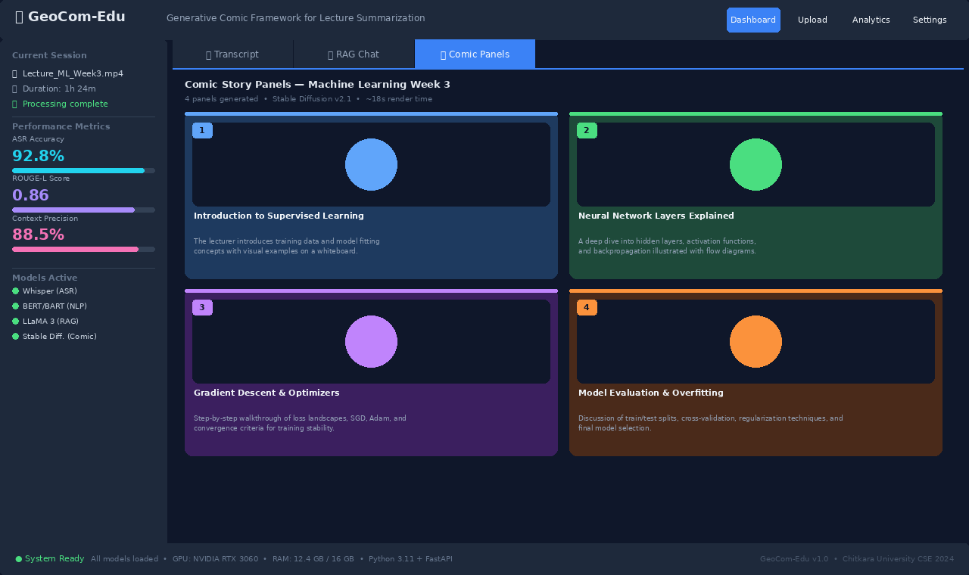
Project Demo — Application Screenshot
7
GeoCom-Edu React.js Interface — Comic Panels tab showing 4 AI-generated lecture story panels with live performance metrics (ASR: 92.8%, ROUGE-L: 0.86, Context Precision: 88.5%)

Slide 8
Results & Performance
Quantitative Performance Metrics
ASR Accuracy (Whisper): 92.8% — tested on real university lecture recordings of 60-90 minutes
Summarization Quality (BART/PEGASUS): ROUGE-L Score of 0.86 — high relevance and coverage of key lecture concepts
RAG Chatbot Precision (LLaMA 3 / Groq): Context Match of 88.5% — correct and relevant answers to student queries
Qualitative Results (Student and Educator Feedback)
Greater comprehension of lecture material with structured summaries and visual panels
Significantly shorter time needed to revisit and locate important sections
Increased student engagement due to comic-style visual storytelling
Instructors found the platform valuable for adapting course content and supporting classroom activities
Comparative Advantage
GeoCom-Edu outperforms Otter.ai, ChatGPT, and Notion AI in: offline operation, lecture-focused design, RAG-based Q&A, comic visualization, and data privacy (local storage)
7

Slide 9
Comparison & Future Work
Future Work
Regional Language Support: Expand ASR and NLP pipeline to Hindi and other Indian regional languages for broader accessibility
Adaptive Analytics: Monitor per-student comprehension levels and personalize content summaries dynamically for individual learners
Mobile Applications: Develop streamlined Android and iOS apps for on-the-go lecture access and offline study
Voice-Driven Chat: Enable real-time spoken questions with immediate visual comic responses — hands-free interaction mode
Comparison with Existing Tools
Offline Operation: GeoCom-Edu (Yes) vs Otter.ai (No) vs ChatGPT/Notion AI (No)
Lecture-Focused Design: GeoCom-Edu (Yes) vs Otter.ai (Partial) vs ChatGPT/Notion AI (No)
RAG-Based Q&A on Lectures: GeoCom-Edu (Yes) vs Otter.ai (No) vs ChatGPT/Notion AI (Limited)
Comic Visualization: GeoCom-Edu (Yes) vs Otter.ai (No) vs ChatGPT/Notion AI (No)
Data Privacy (Local Storage): GeoCom-Edu (High) vs Otter.ai (Medium) vs ChatGPT/Notion AI (Medium)
8

Slide 10
Conclusion
Summary
GeoCom-Edu demonstrates how Generative AI can transcend automation to become a creative partner in education
By fusing Whisper ASR, BERT/BART NLP, FAISS-based RAG, and Stable Diffusion into a single offline platform, the system transforms passive lecture consumption into active multi-modal learning
Impact
Students comprehend more, revisit content faster, and stay engaged through visual comic narratives — all without sacrificing data privacy or incurring cloud subscription costs
The platform is scalable, affordable, and sustainable for educational institutions aiming to integrate AI technologies
Key Contribution
First fully integrated, offline, privacy-oriented AI system combining speech recognition, NLP summarization, context-aware Q&A, and generative comic visualization specifically designed for academic lecture content
Published as an IEEE conference paper by Pranzal Yadav, Shivain Chhibber, and Gursewak Bhatia — Department of CSE, Chitkara University, Rajpura
9

Slide 11
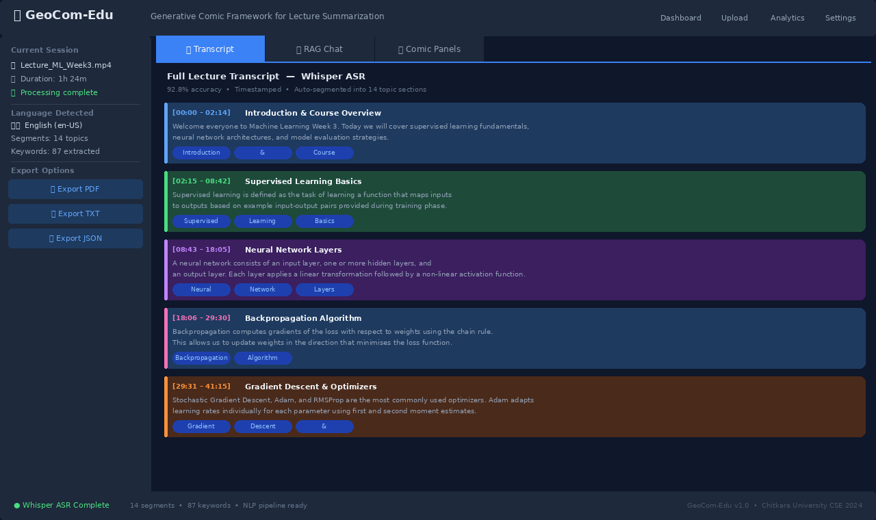
Screenshot 1 — Transcript Tab (Whisper ASR)
Timestamped lecture transcript with 14 auto-segmented topic sections, keyword chips, and PDF/TXT/JSON export options

Slide 12
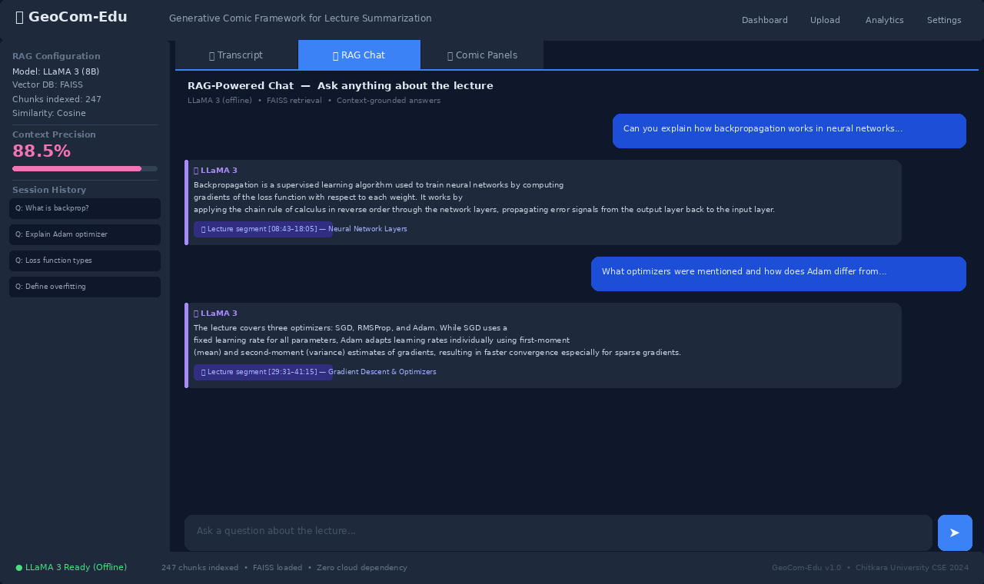
Screenshot 2 — RAG Chat Interface (LLaMA 3)
Offline RAG-powered Q&A: LLaMA 3 answers student questions grounded in FAISS-indexed lecture segments with source citations

Slide 13
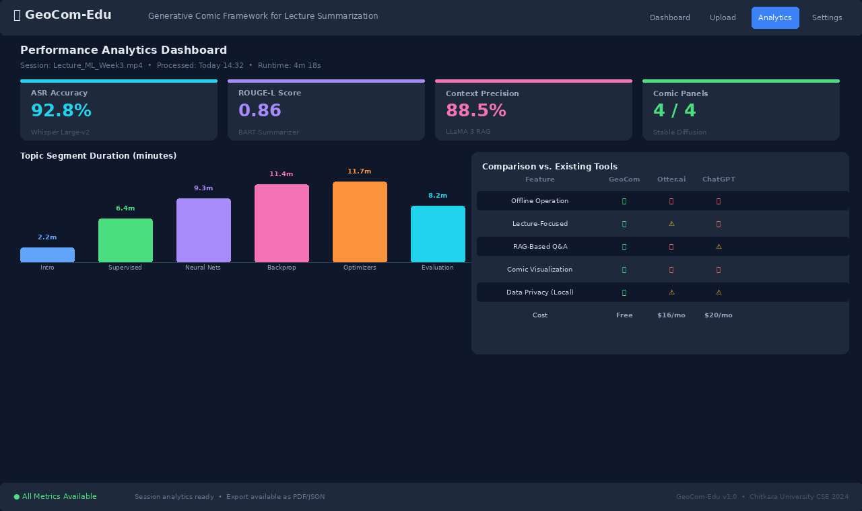
Screenshot 3 — Analytics Dashboard
Live performance metrics (ASR 92.8%, ROUGE-L 0.86, Context Precision 88.5%) with segment duration chart and tool comparison table

Slide 14
Thank You
10

